Slide 1
SMART DUSTBIN
presentation

Slide 2
contents
Introduction
Problem faced
solution
Components and working
Advantages
future ideas
Future of smart dustbin
conclusion

Slide 3
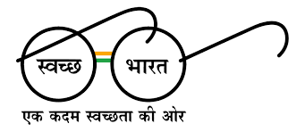
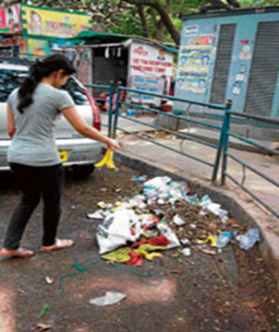
Introduction
Provide an IOT based solution to collecting the garbage
This ensued the greenish in the environment and support for swachh bharat for cleanness.
It is project which supports Swachh Bharat Abhiyan . This concept helps to maintain our environment clean and pollution free.
India generates 63 million tonnes of waste each year.
Over 34 lakh tonnes of plastic was generated in the year 2019-2020

Slide 4
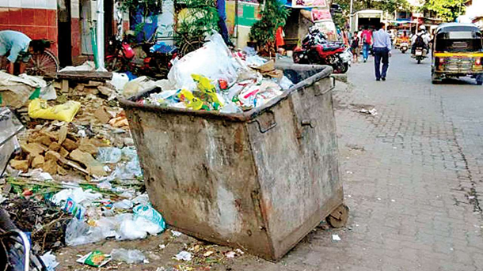
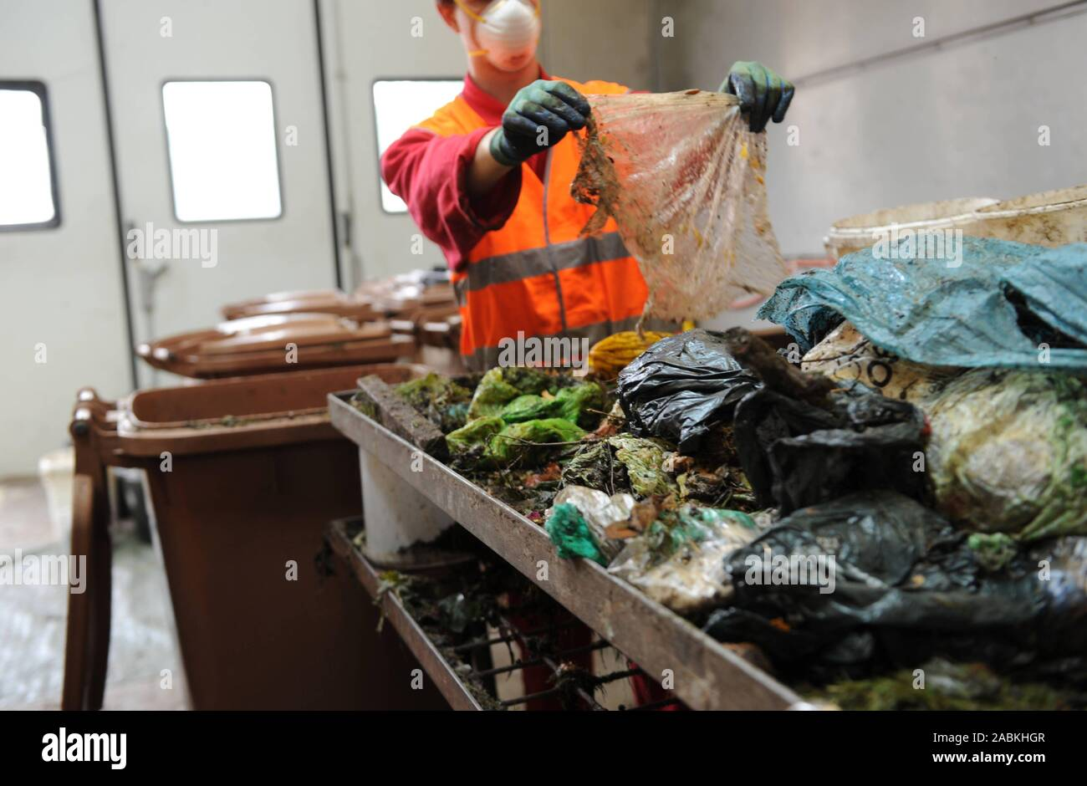
problems
In today world we the people are lazy we don’t care, we don’t mind any small things that matters a lot
world, small issues which leads to big problem like global warming
This leads to some of the environmental problem
People are dumping their waste such dustbin leads to problem to segregate the waste

Slide 5
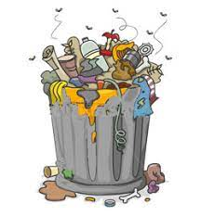
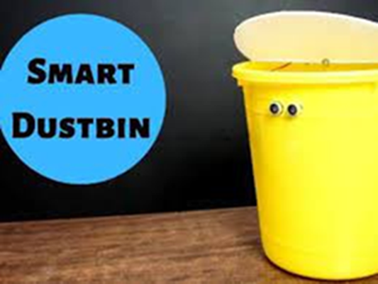
solution
To come out of such hazardous we face. presenting you a new way of technology called Smart dustbin
Which make people life easier
it doesn’t need any manual operation which simply mean automatic by using sensor
Since the dustbin contains thousands of bacteria over it which affects the human health easily
This can be avoided by using smart dustbin

Slide 6
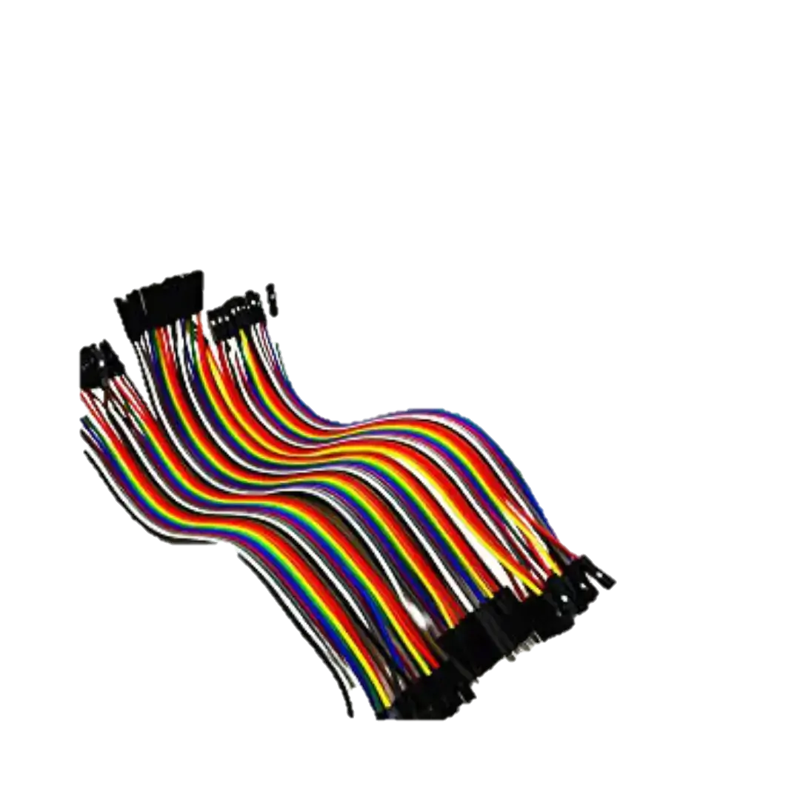
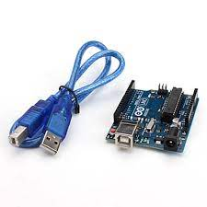
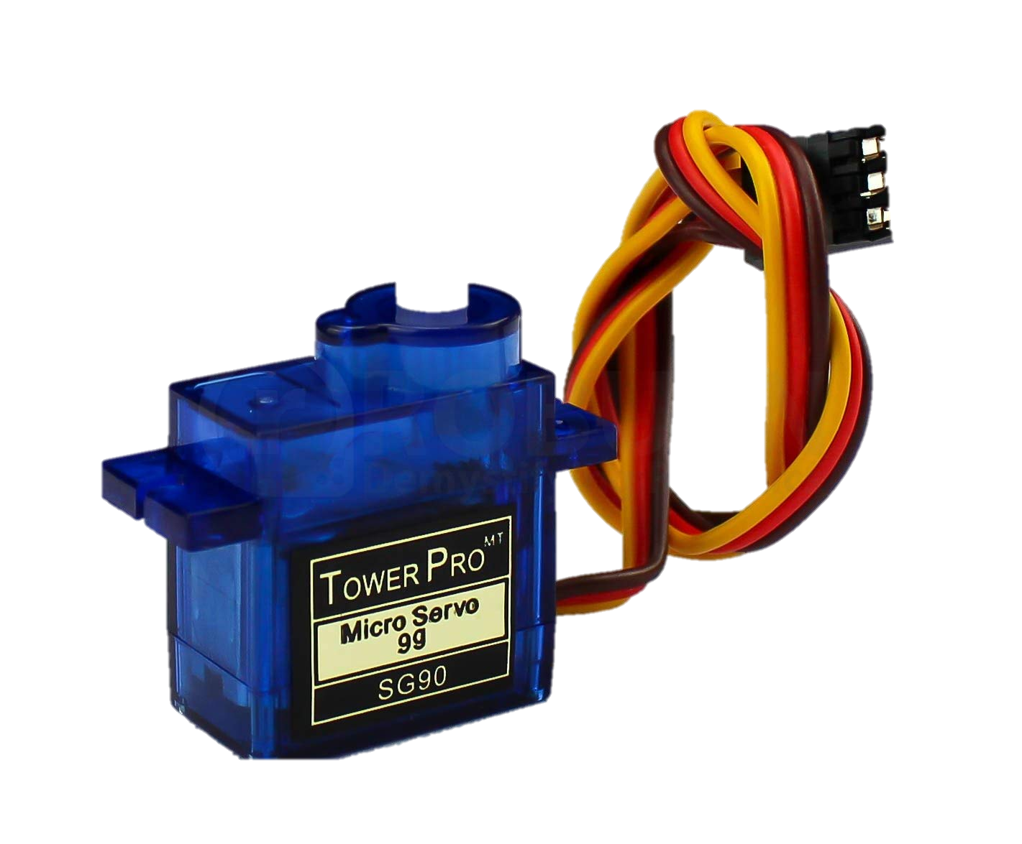
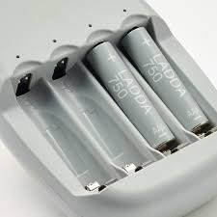
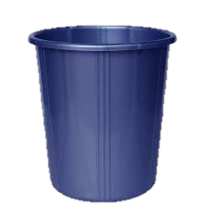
components
In this we used a following components
Arduino uno board
Ultra sonic sensor
servo motor
9v battery
Dustbin
Servo motor
Jumper wires (male to female)

Slide 7
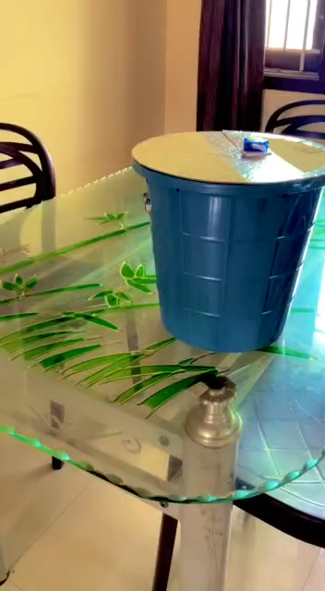

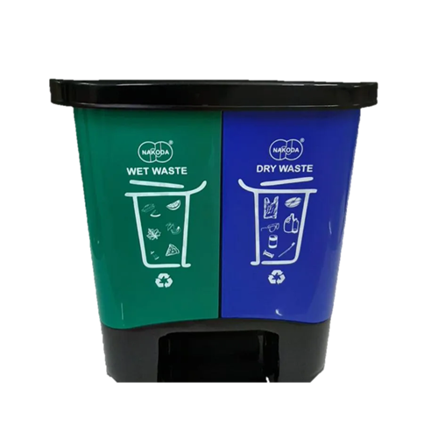
Working
It works based on the ultrasonic sensor which execute in a particular range
When an object where comes into a range the sensor recognise and opens the led
After we moved the led will closed automatically

Slide 8
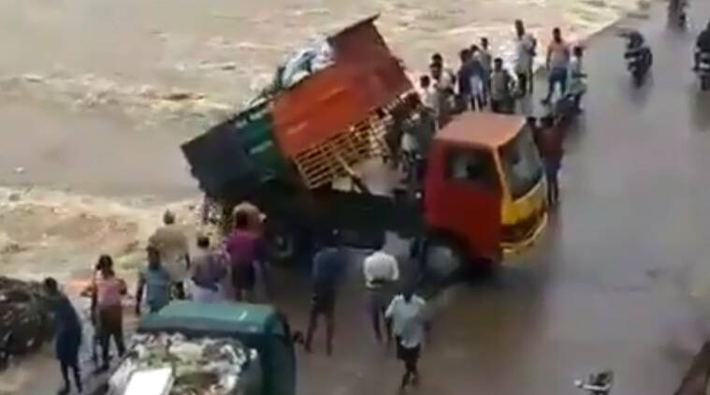
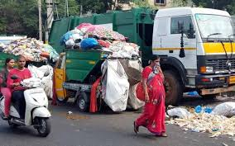
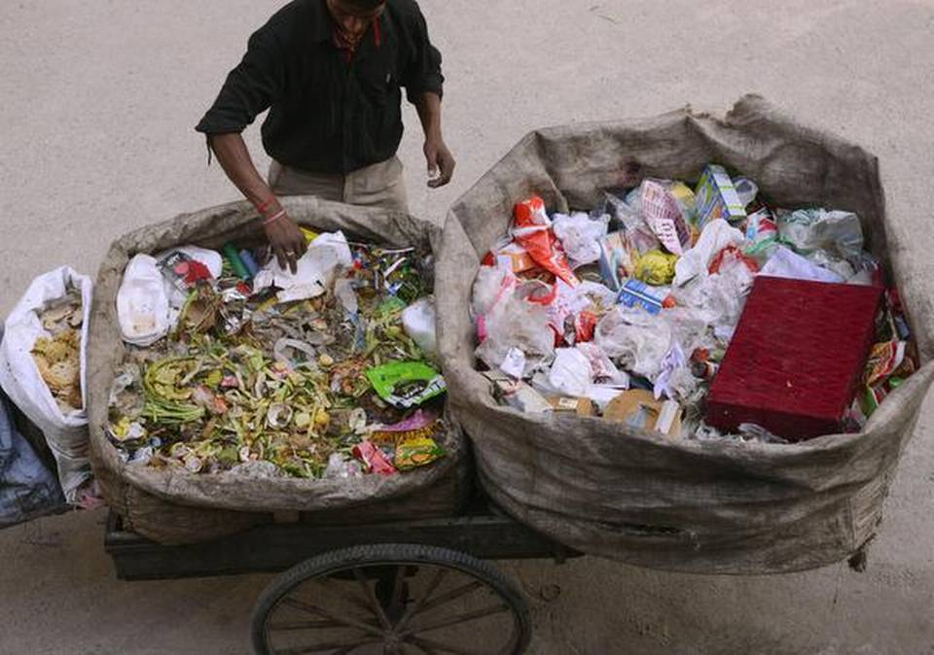
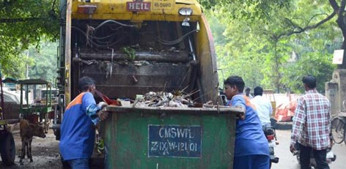
1.advantages
Reduce man power
We can stop polluting the river
Easy for segregate
Bio & non bio waste
Even kids loves to use that
So that in future they will be responsible
Since the dustbin contains thousands of bacteria over it ne need to touch or open the bin
We can use in Medical sectors

Slide 9
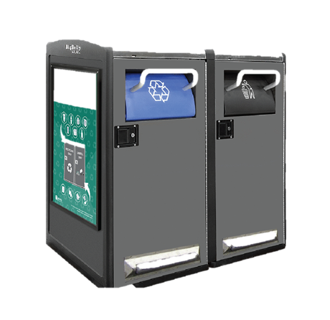
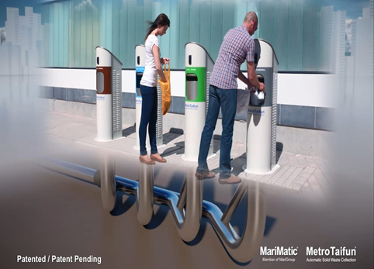
Future Ideas
Sensor that shows the level of trash in the dustbin
Also we can use solar panel for the power consumption
Using AI the dustbin recognise what type of waste
Also we can use speakers that sounds after closing the bin it says “thank you for using me” message
By using this tunnel method
Reduce traffic problems No need or big trucks
Segregation process is done easily

Slide 10
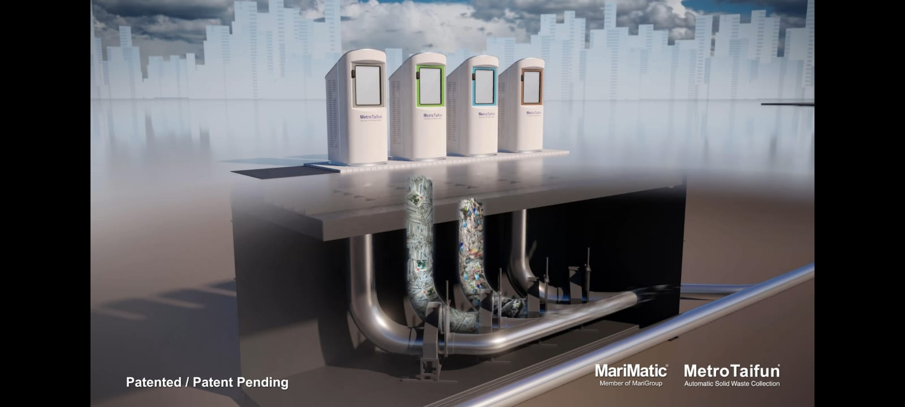
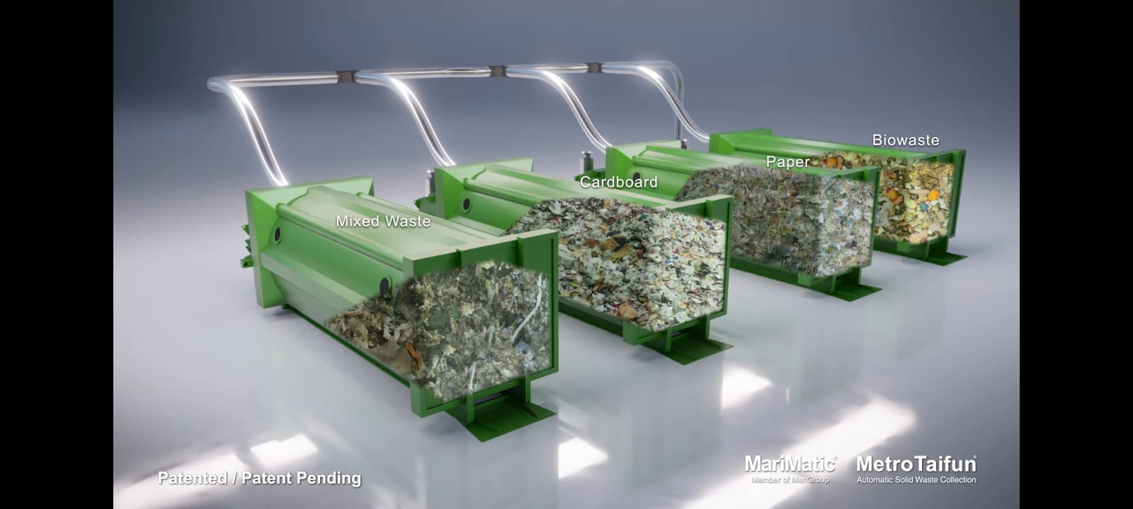
Future of smart dustbin
Using tunnel method dustbin reduces the traffic problems
Reduces the man power
The dustbin won’t get filled
When the bin is almost going to fill it send the trash to
segregation place (using high pressure pump)
using this we can segregate the
waste into different categories
Medical waste
E waste
bio degradable waste
Non bio degradable waste

Slide 11
THANK YOU
– Art Star

